Slide 1
Unit IV
Client side programming
(Javascript)

Slide 2
Topics
Client side programming
JavaScript
Incorporating JavaScript in HTML
JavaScript expressions
Control flow and functions
String and arrays
JavaScript objects
JavaScript forms
History
Location

Slide 3
Client side programming
Client side programming describes any core that are designed to be executed by the web browser.
Client side scripting provides a broad range of functions.
Client side programming is good for visual effects and form validation.
The program runs directly on the computer of the site visitor
Add dynamic features to web pages, such as reacting to user events (mouse clicks, key presses)
In the worst case scenario the page will not be displayed correctly

Slide 4
What is JavaScript?
Created by Netscape
Originally called LiveWire then LiveScript
A client-side scripting language
Client-side refers to the fact that it is executed in the client (software) that the viewer is using. In the case of JavaScript, the client is the browser.
A server-side language is one that runs on the Web server. Examples: PHP, Python
Interpreted on-the-fly by the client
Each line is processed as it loads in the browser

Slide 5
What is JavaScript?
JavaScript was designed to add interactivity to HTML pages & JavaScript is a scripting language.
A scripting language is a lightweight programming language.
JavaScript is usually embedded directly into HTML pages.
JavaScript is an interpreted language (means that scripts execute without preliminary compilation)
Everyone can use JavaScript without purchasing a license.
JavaScript is used in millions of Web pages to add functionality, validate forms, detect browsers and much more.
JavaScript is the most popular scripting language on the internet, and works in all major browsers, such as Internet Explorer, Firefox, Chrome, Opera, and Safari.

Slide 6
JavaScript is not Java
Completely different types of languages that just happen to be similarly name
JavaScript - programs are interpreted in the browser
Java - programs can be run as stand alone applications

Slide 7
Why JavaScript?
It’s easier to learn than most programming languages
It allows you to make interactive Web pages
Syntax is similar to C
It can be fun..!!

Slide 8
What can JavaScript do?
JavaScript gives HTML designers a programming tool - HTML authors are normally not programmers, but JavaScript is a scripting language with a very simple syntax! Almost anyone can put small "snippets" of code into their HTML pages
JavaScript can put dynamic text into an HTML page - A JavaScript statement like this: document.write("<h1>" + name + "</h1>") can write a variable text into an HTML page
JavaScript can react to events - A JavaScript can be set to execute when something happens, like when a page has finished loading or when a user clicks on an HTML element
JavaScript can read and write HTML elements - A JavaScript can read and change the content of an HTML element
JavaScript can be used to validate data - A JavaScript can be used to validate form data before it is submitted to a server. This saves the server from extra processing
JavaScript can be used to detect the visitor's browser - A JavaScript can be used to detect the visitor's browser, and - depending on the browser - load another page specifically designed for that browser
JavaScript can be used to create cookies - A JavaScript can be used to store and retrieve information on the visitor's computer

Slide 9
<script> tag
The HTML <script> tag is used to insert a JavaScript into an HTML page.
Inside the <script> tag we use the type attribute to define the scripting language.
So, the <script type="text/javascript"> and </script> tells where the JavaScript starts and ends
<html> <body> <script type="text/javascript"> ... </script> </body> </html>

Slide 10
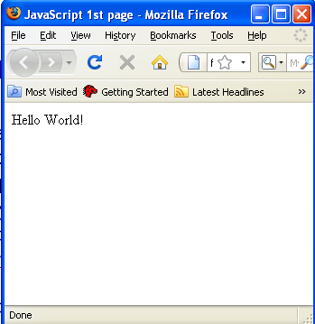
Put a JavaScript into HTML page
The example below shows how to use JavaSript to write text on a web page:
<html> <body> <script type="text/javascript"> document.write("Hello World!"); </script> </body> </html>
If we had not entered the <script> tag, the browser would have treated the document.write("Hello World!") command as pure text, and just write the entire line on the page.

Slide 11
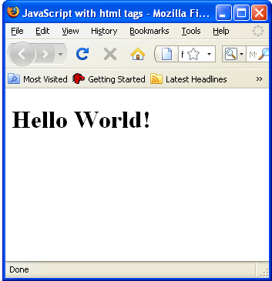
The example below shows how to add HTML tags to the JavaScript:
<html> <body> <script type="text/javascript"> document.write("<h1>Hello World!</h1>"); </script> </body> </html>
The document.write command is a standard JavaScript command for writing output to a page.
By entering the document.write command between the <script> and </script> tags, the browser will recognize it as a JavaScript command and execute the code line. In this case the browser will write Hello World! to the page:

Slide 12
Where to put JavaScript?
In Head
In Body
In Head and Body
External JavaScript
JavaScripts in the body section will be executed WHILE the page loads.
JavaScripts in the head section will be executed when CALLED.
JavaScripts in a page will be executed immediately while the page loads into the browser. This is not always what we want. Sometimes we want to execute a script when a page loads, other times when a user triggers an event.

Slide 13
Scripts in <head>
Scripts to be executed when they are called, or when an event is triggered, go in the head section.
If you place a script in the head section, you will ensure that the script is loaded before anyone uses it.
<html> <head> <script type="text/javascript"> function message() { alert("This alert box was called with the onload event"); } </script> </head> <body onload="message()"> </body> </html>
Here the message is displayed when the onload event occurs

Slide 14
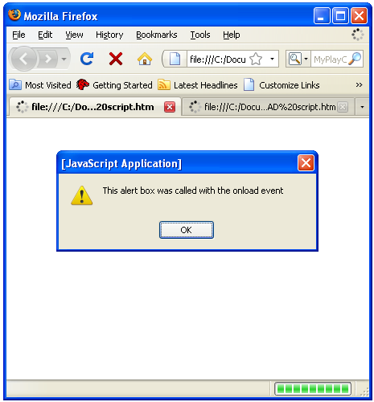
The web page will show this output

Slide 15
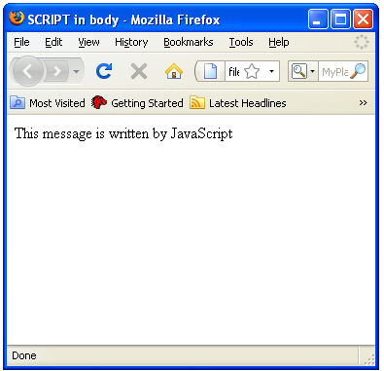
Scripts in the body
Scripts to be executed when the page loads go in the body section.
If you place a script in the body section, it generates the content of a page.
<html> <head> </head> <body> <script type="text/javascript"> document.write("This message is written by JavaScript"); </script> </body> </html>

Slide 16
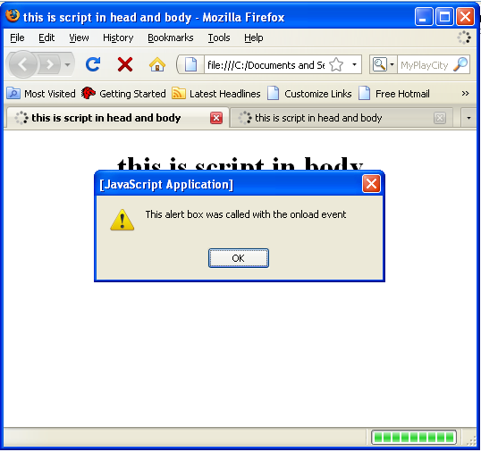
Scripts in <head> and <body>
You can place an unlimited number of scripts in your document, so you can have scripts in both the body and the head section.
<html> <head> <script type="text/javascript"> .... </script> </head> <body> <script type="text/javascript"> .... </script> </body>

Slide 17
Using an external JavaScript
If you want to run the same JavaScript on several pages, without having to write the same script on every page, you can write a JavaScript in an external file.
Save the external JavaScript file with a .js file extension.
The external script cannot contain the <script> tag!
To use the external script, point to the .js file in the "src" attribute of the <script> tag.
Remember to place the script exactly where you normally would write the script!

Slide 18
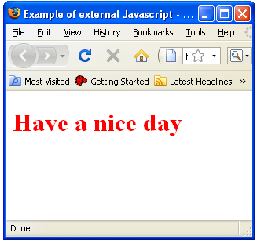
<html> <head> <script type="text/javascript" src=“abc.js"></script> </head> <body> </body> </html>
/* .htm file */
document.write("<font color=red><h1>Have a nice day</h1></font>");
/* .js file */
/* Output file */

Slide 19
JavaScript statements
Unlike HTML, JavaScript is case sensitive - therefore watch your capitalization closely when you write JavaScript statements, create or call variables, objects and functions.
A JavaScript statement is a command to a browser. The purpose of the command is to tell the browser what to do.
This JavaScript statement tells the browser to write "Hello World" to the web page:
document.write("Hello World");
It is normal to add a semicolon at the end of each executable statement.
The semicolon is optional (according to the JavaScript standard), and the browser is supposed to interpret the end of the line as the end of the statement.
Using semicolons makes it possible to write multiple statements on one line.

Slide 20
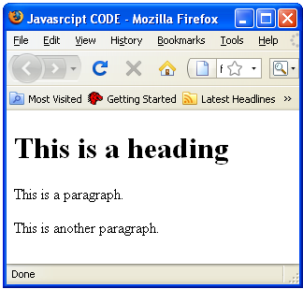
JavaScript code
JavaScript code (or just JavaScript) is a sequence of JavaScript statements.
Each statement is executed by the browser in the sequence they are written.
This example will write a heading and two paragraphs to a web page:
Example
<script type="text/javascript">
document.write("<h1>This is a heading</h1>");
document.write("<p>This is a paragraph.</p>");
document.write("<p>This is another paragraph.</p>");
</script>

Slide 21
JavaScript blocks
JavaScript statements can be grouped together in blocks.
Blocks start with a left curly bracket {, and ends with a right curly bracket }.
The purpose of a block is to make the sequence of statements execute together.
This example will write a heading and two paragraphs to a web page:
Example
<script type="text/javascript"> { document.write("<h1>This is a heading</h1>"); document.write("<p>This is a paragraph.</p>"); document.write("<p>This is another paragraph.</p>"); } </script>
The example above is not very useful. It just demonstrates the use of a block.
Normally a block is used to group statements together in a function or in a condition (where a group of statements should be executed if a condition is met).

Slide 22
JavaScript comments
JavaScript comments can be used to make the code more readable.
Single line comments start with //.
Multi line comments start with /* and end with */.
<script type="text/javascript"> /* The code below will write one heading and two paragraphs */
// Write a heading document.write("<h1>This is a heading</h1>"); //Write two paragraphs: document.write("<p>This is a paragraph.</p>"); document.write("<p>This is another paragraph.</p>"); </script>

Slide 23
JavaScript variables
Variables are "containers" for storing information.
JavaScript variables are used to hold values or expressions.
A variable can have a short name, like x, or a more descriptive name, like carname.
Rules for JavaScript variable names:
Variable names are case sensitive (y and Y are two different variables)
Variable names must begin with a letter or the underscore character
Because JavaScript is case-sensitive, variable names are case-sensitive.

Slide 24
Creating JavaScript variables
Creating variables in JavaScript is most often referred to as "declaring" variables.
You can declare JavaScript variables with the var statement:
var x; var carname;
After the declaration shown above, the variables are empty (they have no values yet).
However, you can also assign values to the variables when you declare them:
var x=5; var carname="Volvo";
After the execution of the statements above, the variable x will hold the value 5, and carname will hold the value Volvo.
When you assign a text value to a variable, use quotes around the value.

Slide 25
Assigning values to undeclared JavaScript variables
If you assign values to variables that have not yet been declared, the variables will automatically be declared.
These statements:
x=5; carname="Volvo";
have the same effect as:
var x=5; var carname="Volvo";
Redeclaring JavaScript Variables
If you redeclare a JavaScript variable, it will not lose its original value.
var x=5; var x;
After the execution of the statements above, the variable x will still have the value of 5. The value of x is not reset (or cleared) when you redeclare it.

Slide 26
Lifetime of JavaScript variables
If you declare a variable within a function, the variable can only be accessed within that function.
When you exit the function, the variable is destroyed. These variables are called local variables.
You can have local variables with the same name in different functions, because each is recognized only by the function in which it is declared.
Global vrs: If you declare a variable outside a function, all the functions on your page can access it.
The lifetime of these variables starts when they are declared, and ends when the page is closed.

Slide 27
JavaScript operators
JavaScript operators are:
Arithmetic Operators
Assignment Operators
Comparison Operators
Logical Operators
Conditional Operator

Slide 28
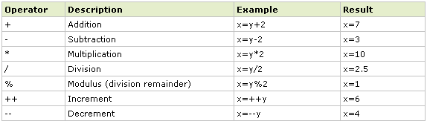
JavaScript Arithmetic operators
Arithmetic operators are used to perform arithmetic between variables and/or values.
Given that y=5, the table below explains the arithmetic operators:

Slide 29
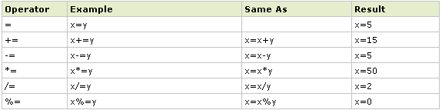
JavaScript Assignment operators
Assignment operators are used to assign values to JavaScript variables.
Given that x=10 and y=5, the table below explains the assignment operators:

Slide 30
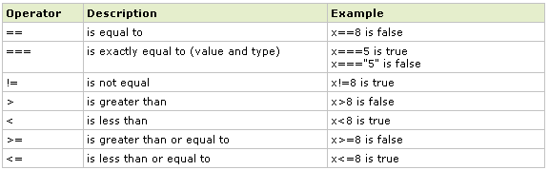
JavaScript Comparison operators
Comparison operators are used in logical statements to determine equality or difference between variables or values.
Comparison operators can be used in conditional statements to compare values and take action depending on the result:
if (age<18) document.write("Too young");
Given that x=5, the table below explains the comparison operators:

Slide 31

JavaScript Logical operators
Logical operators are used to determine the logic between variables or values.
Given that x=6 and y=3, the table below explains the logical operators:

Slide 32
JavaScript Conditional operator
JavaScript also contains a conditional operator that assigns a value to a variable based on some condition.
Syntax
variablename=(condition)?value1:value2
Example
greeting=(visitor=="PRES")?"Dear President ":"Dear ";
If the variable visitor has the value of "PRES", then the variable greeting will be assigned the value "Dear President " else it will be assigned "Dear".

Slide 33
Control flow
One of the most powerful features of JavaScript (and every other programming or scripting language for that matter) is the ability to build intelligence and logic into your web pages.
It is vital in constructing scripts to be able to have the script make decisions and repeat tasks until specified criteria are met.
For example, if you are developing an e-commerce application you may want to repeatedly ask a user to enter a credit card number until a valid credit card number is entered.
Alternatively, you may want your script to loop a specific number of times through a task before moving on to the next part of the script.
All of this logic and flow control is achieved using some very simple structures.

Slide 34
Control flow includes
Conditional Statements
if statements
if ... else ... statements
Switch Statement
Looping Statements
while loops
do ... while loops
break

Slide 35
Conditional statements
Conditional statements are used to perform different actions based on different conditions.
Conditional statements execute a set of other statements only if certain conditions are met.
In JavaScript we have the following conditional statements:
if statement - use this statement to execute some code only if a specified condition is true
if...else statement - use this statement to execute some code if the condition is true and another code if the condition is false
if...else if....else statement - use this statement to select one of many blocks of code to be executed
switch statement - use this statement to select one of many blocks of code to be executed

Slide 36
If statement
Use the if statement to execute some code only if a specified condition is true.
Syntax
if (condition) { code to be executed if condition is true }
Note that if is written in lowercase letters.
Using uppercase letters (IF) will generate a JavaScript error!

Slide 37
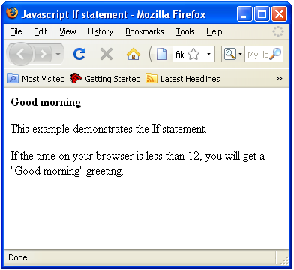
If statement example
<script type="text/javascript"> //Write a "Good morning" greeting if //the time is less than 12 var d=new Date(); var time=d.getHours(); if (time<12) { document.write("<b>Good morning</b>"); } </script>

Slide 38
If….else statement
Use the if....else statement to execute some code if a condition is true and another code if the condition is not true.
Syntax
if (condition) { code to be executed if condition is true } else { code to be executed if condition is not true }

Slide 39
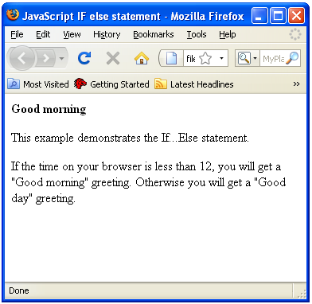
Example
<script type="text/javascript"> //If the time is less than 12, you will get a "Good morning" greeting. //Otherwise you will get a "Good day" greeting. var d = new Date(); var time = d.getHours(); if (time < 12) { document.write("Good morning!"); } else { document.write("Good day!"); } </script>

Slide 40
If..else if…statement
Use the if....else if...else statement to select one of several blocks of code to be executed.
Syntax
if (condition1) { code to be executed if condition1 is true } else if (condition2) { code to be executed if condition2 is true } else { code to be executed if condition1 and condition2 are not true }

Slide 41
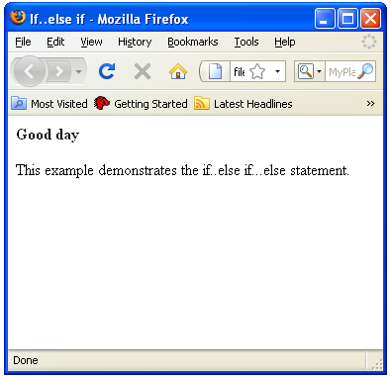
Example
<script type="text/javascript"> var d = new Date() var time = d.getHours() if (time<10) { document.write("<b>Good morning</b>"); } else if (time>10 && time<16) { document.write("<b>Good day</b>"); } else { document.write("<b>Hello World!</b>"); } </script>

Slide 42
Switch statement
Use the switch statement to select one of many blocks of code to be executed.
Syntax
switch(n) { case 1: execute code block 1 break; case 2: execute code block 2 break; default: code to be executed if n is different from case 1 and 2 }

Slide 43
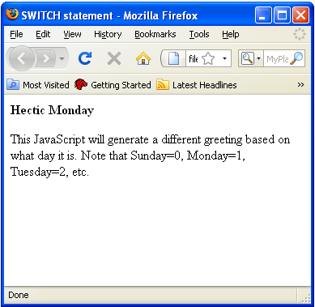
Example
<script type="text/javascript"> //You will receive a different greeting based //on what day it is. Note that Sunday=0, //Monday=1, Tuesday=2, etc. var d=new Date(); theDay=d.getDay(); switch (theDay) { case 5: document.write("Finally Friday"); break; case 6: document.write("Super Saturday"); break; case 0: document.write("Sleepy Sunday"); break; default: document.write("I'm looking forward to this weekend!"); } </script>

Slide 44
JavaScript functions
A function will be executed by an event or by a call to the function.
To keep the browser from executing a script when the page loads, you can put your script into a function.
A function contains code that will be executed by an event or by a call to the function.
You may call a function from anywhere within a page (or even from other pages if the function is embedded in an external .js file).
Functions can be defined both in the <head> and in the <body> section of a document. However, to assure that a function is read/loaded by the browser before it is called, it could be wise to put functions in the <head> section.

Slide 45
How to define a function
Syntax
function functionname(var1,var2,...,varX) { some code }
The parameters var1, var2, etc. are variables or values passed into the function.
The { and the } defines the start and end of the function.
A function with no parameters must include the parentheses () after the function name.
Syntax
function functionname()
{
some code
}

Slide 46
How to call a function
A function is not executed before it is called.
You can call a function with some arguments as follows:
functionname(argument1, argument2)
or without arguments as follows:
functionname()

Slide 47
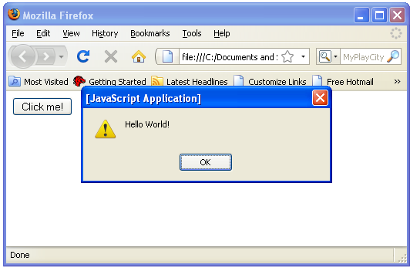
Function example
<html> <head> <script type="text/javascript"> function displaymessage() { alert("Hello World!"); } </script> </head> <body> <form> <input type="button" value="Click me!"
onclick="displaymessage()" /> </form> </body> </html>
If the line: alert("Hello world!!") in the example above had not been put within a function, it would have been executed as soon as the line was loaded.
Now, the script is not executed before a user hits the input button.
The function displaymessage() will be executed if the input button is clicked.

Slide 48
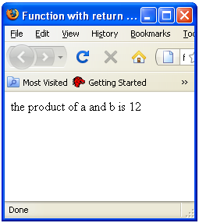
The return statement
The return statement is used to specify the value that is returned from the function.
So, functions that are going to return a value must use the return statement.
The example below returns the product of two numbers (a and b):
<html> <head> <script type="text/javascript"> function product(a,b) { return a*b; } </script> </head> <body> <script type="text/javascript"> document.write(product(4,3)); </script> </body> </html>

Slide 49
JavaScript Loops
Loops execute a block of code a specified number of times, or while a specified condition is true.
Often when you write code, you want the same block of code to run over and over again in a row.
Instead of adding several almost equal lines in a script we can use loops to perform a task like this.
In JavaScript, there are two different kind of loops:
for - loops through a block of code a specified number of times
while - loops through a block of code while a specified condition is true

Slide 50
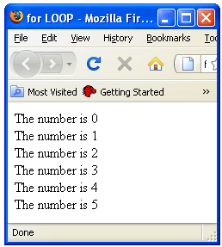
for Loop
The for loop is used when you know in advance how many times the script should run.
Syntax
for (var=startvalue;var<=endvalue;var=var+increment) { code to be executed }
The example below defines a loop that starts with i=0. The loop will continue to run as long as i is less than, or equal to 5. i will increase by 1 each time the loop runs.
The increment parameter could also be negative, and the <= could be any comparing statement.
Example
<html> <body> <script type="text/javascript"> var i=0; for (i=0;i<=5;i++) { document.write("The number is " + i); document.write("<br />"); } </script> </body> </html>

Slide 51
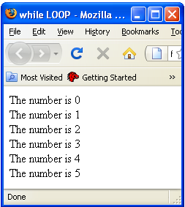
while Loop
The while loop loops through a block of code while a specified condition is true.
Syntax
while (var<=endvalue) { code to be executed }
The <= could be any comparing statement.
The example below defines a loop that starts with i=0. The loop will continue to run as long as i is less than, or equal to 5. i will increase by 1 each time the loop runs:
Example
<html> <body> <script type="text/javascript"> var i=0; while (i<=5) { document.write("The number is " + i); document.write("<br />"); i++; }
</script> </body> </html>

Slide 52
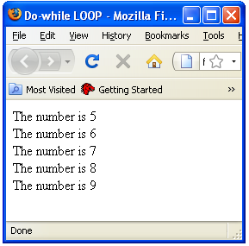
do….while Loop
The do...while loop is a variant of the while loop. This loop will execute the block of code ONCE, and then it will repeat the loop as long as the specified condition is true.
Syntax
do { code to be executed } while (var<=endvalue);
The do...while loop will always be executed at least once, even if the condition is false, because the statements are executed before the condition is tested:
Example
<html> <body> <script type="text/javascript"> var i=5; do { document.write("The number is " + i); document.write("<br />"); i++; } while (i<=9); </script> </body> </html>

Slide 53
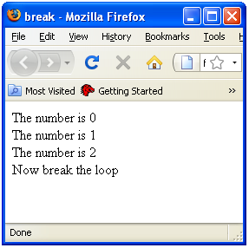
break statement
The break statement will break the loop and continue executing the code that follows after the loop (if any).
Example
<html> <body> <script type="text/javascript"> var i=0; for (i=0;i<=10;i++) { if (i==3) { break; } document.write("The number is " + i); document.write("<br />"); } </script> </body> </html>

Slide 54
JavaScript popup boxes
JavaScript has three kind of popup boxes:
Alert box
Confirm box
Prompt box

Slide 55
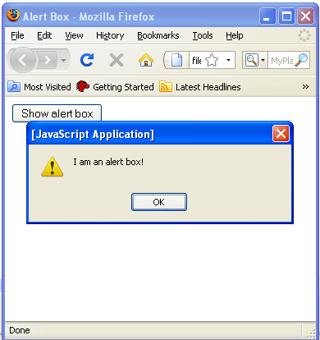
Alert box
An alert box is often used if you want to make sure information comes through to the user.
When an alert box pops up, the user will have to click "OK" to proceed.
Syntax
alert("some text");
<html>
<head>
<script type="text/javascript">
function show_alert()
{
alert("I am an alert box!");
}
</script>
</head>
<body>
<input type="button" onclick="show_alert()" value="Show alert box" />
</body>
</html>

Slide 56
Confirm box
A confirm box is often used if you want the user to verify or accept something.
When a confirm box pops up, the user will have to click either "OK" or "Cancel" to proceed.
If the user clicks "OK", the box returns true. If the user clicks "Cancel", the box returns false.
Syntax
confirm("some text");

Slide 57
<html> <head> <script type="text/javascript"> function show_confirm() { var r=confirm("Press a button"); if (r==true) { document.write("You pressed OK!"); } else { document.write("You pressed Cancel!"); } } </script> </head> <body> <input type="button" onclick="show_confirm()" value="Show confirm box" /> </body> </html>

Slide 58
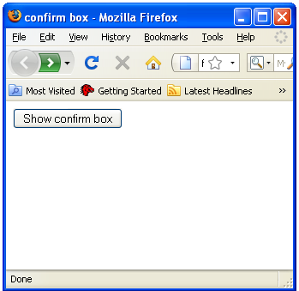
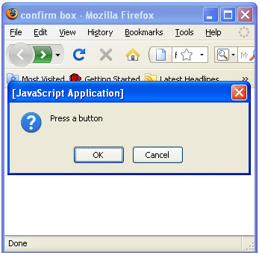

Slide 59
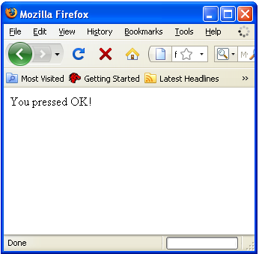
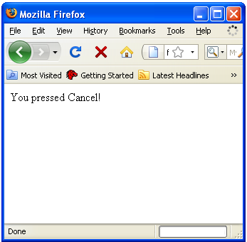

Slide 60
Prompt box
A prompt box is often used if you want the user to input a value before entering a page.
When a prompt box pops up, the user will have to click either "OK" or "Cancel" to proceed after entering an input value.
If the user clicks "OK" the box returns the input value. If the user clicks "Cancel" the box returns null.
Syntax
prompt("sometext","defaultvalue");

Slide 61
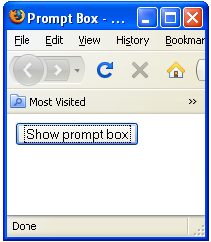
<html> <head> <script type="text/javascript"> function show_prompt() { var name=prompt("Please enter your name"); if (name!=null && name!="") { document.write("Hello " + name + "! How are you today?"); } } </script> </head> <body> <input type="button" onclick="show_prompt()" value="Show prompt box" /> </body> </html>

Slide 62
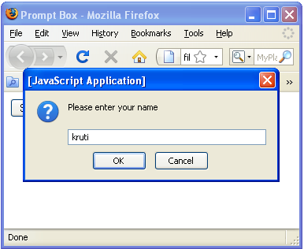
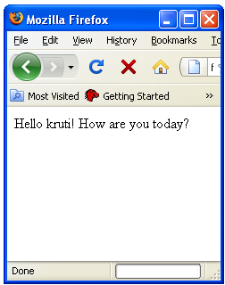

Slide 63
JavaScript object hierarchy
Different components in HTML page are represented as OBJECTS, that can be accessed by JavaScript.
These objects are organized in a hierarchy. (beginning with WINDOW object.)
JavaScript objects originate in one of the four places.
Some are built into the language like; String, Array, Date, Math and object.
Most come from web documents and are made available through client side JavaScript via the document object model (DOM).
A few object come from the browser such as the navigator, location and history objects also made available to the client side by DOM.
Lastly, programmers can create their own custom objects.
JavaScript supports a small handful of “built-in” objects. These built-in objects are available regardless of window content and operate independently of whatever page the browser has loaded.

Slide 64
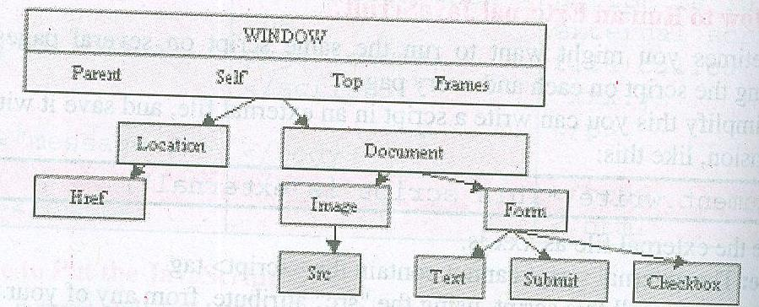
Most of the javascript object come from web documents.
When a web document contains an <img> tag in HTML, that document is said to contain an image object.
If it has a form specified by <form> tag it contains an form object.
It may also have paragraphs, headings, divisions, etc. but only the very latest browsers allow us to access or manipulate those objects.
The document object model implemented by a particular browser determines which objects we can access and manipulate in that browser

Slide 65
JavaScript objects
JavaScript is an Object Oriented Programming (OOP) language.
An OOP language allows you to define your own objects and make your own variable types.
An object is just a special kind of data and it has properties & methods.
Properties: Properties are the values associated with an object.
In the following example we are using the length property of the String object to return the number of characters in a string:
<script type="text/javascript"> var txt="Hello World!"; document.write(txt.length); </script>
The output of the code above will be: 12
Methods: Methods are the actions that can be performed on objects.
In the following example we are using the toUpperCase() method of the String object to display a text in uppercase letters:
<script type="text/javascript"> var str="Hello world!"; document.write(str.toUpperCase()); </script>
The output of the code above will be:HELLO WORLD!

Slide 66
JavaScript objects contd…
Some of JavaScript objects are as follows:
String
Array
History
Location
Navigator
Date
Window
Document
Boolean
Math
RegExp

Slide 67

JavaScript string object
The String object is used to manipulate a stored piece of text.
The String object let's you work with text.
Syntax
var myStr=new String(string);
Properties:

Slide 68
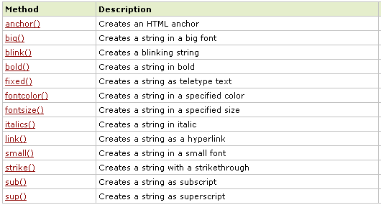
String HTML wrapper methods
The HTML wrapper(predefined) methods return the string wrapped inside the appropriate HTML tag.

Slide 69
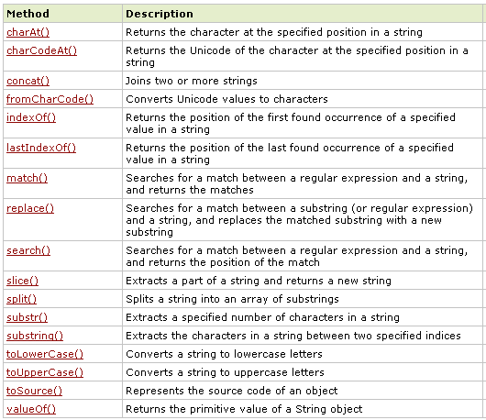
String object methods

Slide 70
JavaScript array
Array object is used to store a set of values in a single variable name
We can create an instance of the array object with the “new” keyword
Syntax
var myCars=new Array("Saab","Volvo","BMW")
To access and to set values inside an array, you must use the index numbers as follows:
myCars[0] is the first element
myCars[1] is the second element
myCars[2] is the third element

Slide 71
Array Object Properties

Slide 72
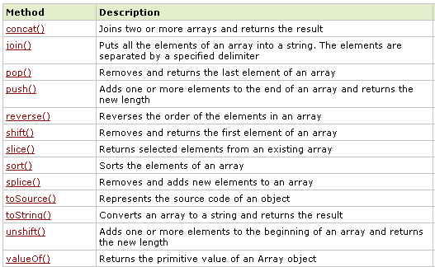
Array object methods

Slide 73

JavaScript Date object
The Date object is used to work with dates and times.
We can create an instance of Date object with the “new” keyword
Syntax
var myDate=new Date()
The Date object will automatically hold the current date and time as its initial value
Date object properties

Slide 74
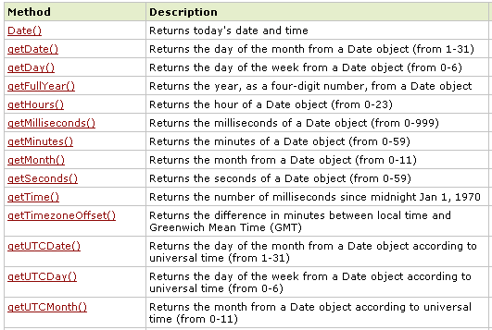
Date object methods

Slide 75
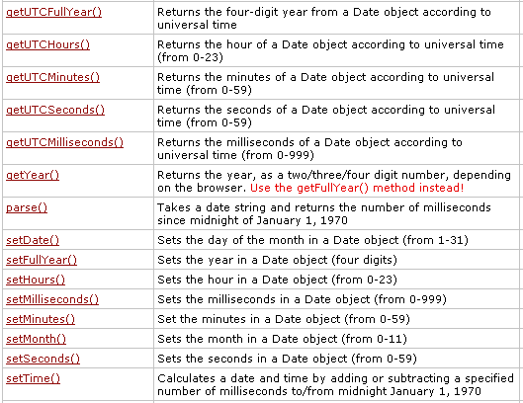

Slide 76
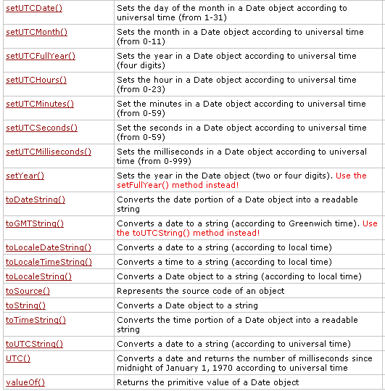

Slide 77
Set Dates
We can easily manipulate the date by using the methods available for the Date object.
In the example below we set a Date object to a specific date (14th January 2010):
var myDate=new Date(); myDate.setFullYear(2010,0,14);
And in the following example we set a Date object to be 5 days into the future:
var myDate=new Date(); myDate.setDate(myDate.getDate()+5);
Compare Two Dates
The Date object is also used to compare two dates.
The following example compares today's date with the 14th January 2010:
var myDate=new Date(); myDate.setFullYear(2010,0,14); var today = new Date(); if (myDate>today) { alert("Today is before 14th January 2010"); } else { alert("Today is after 14th January 2010"); }

Slide 78
Window object
The Window object is the top level object in the JavaScript hierarchy.
The Window object represents a browser window.
A Window object is created automatically with every instance of a <body> or <frameset> tag.

Slide 79
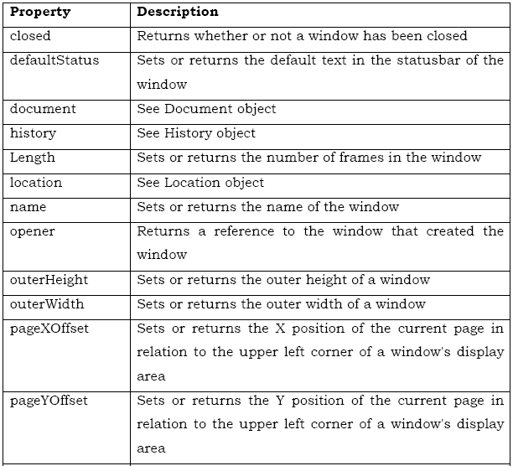
Properties

Slide 80
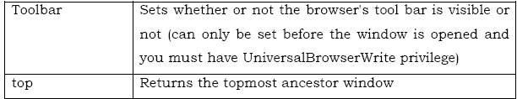
Properties

Slide 81
Methods

Slide 82
Methods

Slide 83
Open method
The syntax of the window.open method is given below: open (URL, windowName[, windowFeatures])
URL The URL of the page to open in the new window. This argument could be blank.
windowName A name to be given to the new window. The name can be used to refer this window again.
windowFeatures A string that determines the various window features to be included in the popup window (like status bar, address bar etc) The following code opens a new browser window with standard features.
window.open ("http://www.javascript-coder.com","mywindow");

Slide 84
The following features are available in most browsers:
toolbar=0|1Specifies whether to display the toolbar in the new window.
location=0|1Specifies whether to display the address line in the new window.
directories=0|1Specifies whether to display the Netscape directory buttons.
status=0|1Specifies whether to display the browser status bar.
menubar=0|1Specifies whether to display the browser menu bar.
scrollbars=0|1Specifies whether the new window should have scrollbars.
resizable=0|1Specifies whether the new window is resizable.
width=pixelsSpecifies the width of the new window.
height=pixelsSpecifies the height of the new window.

Slide 85
The following code opens a window with menu bar. The window is re-sizable and is having 350 pixels width and 250 pixels height.
window.open("http://www.javascriptcoder.com","mywindow","menubar=1,resizable=1,width=350,height=250“);

Slide 86
The Code below opens a popup window when you enter the page:
<html>
<head>
<title>JavaScript Popup Example </title>
</head>
<script type="text/javascript">
function poponload()
{
testwindow = window.open("", "mywindow", "location=1,status=1,scrollbars=1,width=100,height=100");
testwindow.moveTo(0, 0);
}
</script>
<body onload="javascript: poponload()">
<h1>JavaScript Popup Example </h1>
</body>
</html>

Slide 87
Popup On Exit
The following code pops up a window when the user exits a page.
<html>
<head>
<title>JavaScript Popup Example </title>
</head>
<script type="text/javascript">
function exitpop()
{
my_window = window.open("", "mywindow1", "status=1,width=350,height=150");
my_window.document.write('<h1>Popup Test!</h1>');
}
</script>
<body onunload="javascript: exitpop()" >
<h1>JavaScript Popup Example </h1>
</body>
</html>

Slide 88
Closing a new window
<html>
<head>
<script type="text/javascript">
function openWin()
{ myWindow=window.open("","","width=200,height=100");
myWindow.document.write("<p>This is 'myWindow'</p>");
}
function closeWin()
{ myWindow.close();
}
</script>
</head>
<body>
<input type="button" value="Open 'myWindow'" onclick="openWin()" />
<input type="button" value="Close 'myWindow'" onclick="closeWin()" />
</body>
</html>

Slide 89
History object
The History object is actually a JavaScript object, not an HTML DOM object.
The History object is automatically created by the JavaScript runtime engine and consists of an array of URLs.
These URLs are the URLs the user has visited within a browser window.
The History object is part of the Window object and is accessed through the window.history property.

Slide 90
Properties:
Methods:

Slide 91
Displays the number of urls..
<html>
<body>
<script type="text/javascript">
document.write("Number of URLs in history list: " + history.length);
</script>
</body>
</html>

Slide 92
Creates a back button on the page
<html>
<head>
<script type="text/javascript">
function goBack()
{
window.history.back()
}
</script>
</head>
<body>
<input type="button" value="Back" onclick="goBack()" />
<p>Notice that clicking on the Back button here will not result in any action, because there is no previous URL in the history list.</p>
</body>
</html>

Slide 93
Location object
The Location object is actually a JavaScript object, not an HTML DOM object.
The Location object is automatically created by the JavaScript runtime engine and contains information about the current URL.
Example: Send a user to a new location.
The Location object is part of the Window object and is accessed through the window.location property.
Methods:

Slide 94
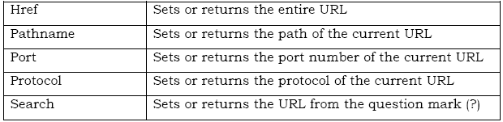
Properties

Slide 95
Return the host name and port of the current url…
<html>
<body>
<script type="text/javascript">
document.write(location.host);
</script>
</body>
</html>

Slide 96
Loads a new document with loc
<html>
<head>
<script type="text/javascript">
function newDoc()
{ window.location.assign("http://www.w3schools.com")
}
</script>
</head>
<body>
<input type="button" value="Load new document" onclick="newDoc()" />
</body>
</html>

Slide 97
Navigator object
The Navigator object is actually a JavaScript object, not an HTML DOM object.
The Navigator object is automatically created by the JavaScript runtime engine and contains information about the client browser.
Methods:

Slide 98
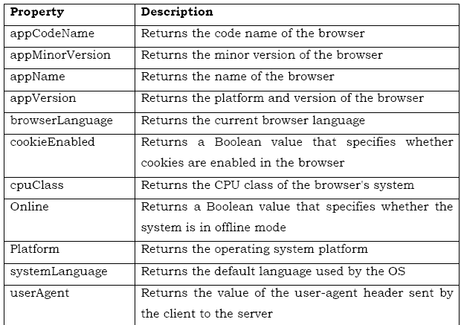
Properties

Slide 99
Document object
The Document object represents the entire HTML document and can be used to access all elements in a page.
The Document object is part of the Window object and is accessed through the window.document property.

Slide 100
Properties

Slide 101
Methods

Slide 102
JavaScript Boolean object
The Boolean object is used to convert a non-Boolean value to a Boolean value (true or false).
Create a Boolean Object
The Boolean object represents two values: "true" or "false".
The following code creates a Boolean object called myBoolean:
var myBoolean=new Boolean();
Note: If the Boolean object has no initial value or if it is 0, -0, null, "", false, undefined, or NaN, the object is set to false. Otherwise it is true (even with the string "false")!
All the following lines of code create Boolean objects with an initial value of false:
var myBoolean=new Boolean(); var myBoolean=new Boolean(0); var myBoolean=new Boolean(null); var myBoolean=new Boolean(""); var myBoolean=new Boolean(false); var myBoolean=new Boolean(NaN);
And all the following lines of code create Boolean objects with an initial value of true:
var myBoolean=new Boolean(true); var myBoolean=new Boolean("true"); var myBoolean=new Boolean("false"); var myBoolean=new Boolean("Richard");

Slide 103
Check the values for true or false
<html>
<body>
<script type="text/javascript">
var b1=new Boolean( 0);
var b2=new Boolean(1);
var b3=new Boolean("");
var b4=new Boolean(null);
var b5=new Boolean(NaN);
var b6=new Boolean("false");
document.write("0 is boolean "+ b1 +"<br />");
document.write("1 is boolean "+ b2 +"<br />");
document.write("An empty string is boolean "+ b3 + "<br />");
document.write("null is boolean "+ b4+ "<br />");
document.write("NaN is boolean "+ b5 +"<br />");
document.write("The string 'false' is boolean "+ b6 +"<br />");
</script>
</body>
</html>

Slide 104
Math object
Math Object
The Math object allows you to perform mathematical tasks.
The Math object includes several mathematical constants and methods.
Syntax for using properties/methods of Math:
var pi_value=Math.PI; var sqrt_value=Math.sqrt(16);
Math is not a constructor. All properties and methods of Math can be called by using Math as an object without creating it.
Mathematical Constants
JavaScript provides eight mathematical constants that can be accessed from the Math object. These are: E, PI, square root of 2, square root of 1/2, natural log of 2, natural log of 10, base-2 log of E, and base-10 log of E.
You may reference these constants from your JavaScript like this:
Math.E Math.PI Math.SQRT2 Math.SQRT1_2 Math.LN2 Math.LN10 Math.LOG2E Math.LOG10E

Slide 105
MAX of numbers
<html>
<body>
<script type="text/javascript">
document.write(Math.max(5,10) + "<br />");
document.write(Math.max(0,150,30,20,38) + "<br />");
document.write(Math.max(-5,10) + "<br />");
document.write(Math.max(-5,-10) + "<br />");
document.write(Math.max(1.5,2.5));
</script>
</body>
</html>

Slide 106
Mathematical Methods
In addition to the mathematical constants that can be accessed from the Math object there are also several methods available.
The following example uses the round() method of the Math object to round a number to the nearest integer:
document.write(Math.round(4.7));
The code above will result in the following output:
5
The following example uses the random() method of the Math object to return a random number between 0 and 1:
document.write(Math.random());
The code above can result in the following output:
0.12142891831885438 or 0.23149013766196702

Slide 107
JavaScript forms
Nothing strikes more fear in the heart of a Web publisher than these three letters: C-G-I. CGI (which stands for common gateway interface), is a mechanism for safely transporting data from a client (a browser like Netscape Navigator) to a server. It is typically used to transfer data from an HTML form to the server.
With JavaScript at your side, you can process simple forms without invoking the server. And when submitting the form to a CGI program is necessary, you can have JavaScript take care of all the preliminary requirements, such as validating input
JavaScript can be used to validate data in HTML forms before sending off the content to a server.
Form data that typically are checked by a JavaScript could be:
has the user left required fields empty?
has the user entered a valid e-mail address?
has the user entered a valid date?
has the user entered text in a numeric field?

Slide 108
Creating JavaScript forms
There are few differences between a straight HTML form and a JavaScript-enhanced form.
The main one being that a JavaScript form relies on one or more event handlers, such as onClick or onSubmit.
These invoke a JavaScript action when the user does something in the form, like clicking a button.
Typical form control objects -- also called "widgets" -- include the following:
Text box for entering a line of text
Push button for selecting an action
Radio buttons for making one selection among a group of options
Check boxes for selecting or deselecting a single, independent option

Slide 109
Form object properties
action - This specifies the URL and CGI script file name the form is to be submitted to. It allows reading or changing the ACTION attribute of the HTML FORM tag.
elements - An array of fields and elements in the form.
encoding - This is a read or write string. It specifies the encoding method the form data is encoded in before being submitted to the server. It corresponds to the ENCTYPE attribute of the FORM tag. The default is "application/x-www-form-urlencoded". Other encoding includes text/plain or multipart/form-data.
length - The number of fields in the elements array. i.e. the length of the elements array.
method - This is a read or write string. It has the value "GET" or "POST".
name - The form name. Corresponds to the FORM Name attribute.

Slide 110
Form objects
button - An GUI pushbutton control. Methods are click(), blur(), and focus().
Attributes:
name - The name of the button
type - The object's type. In this case, "button".
value - The string displayed on the button.
checkbox - An GUI check box control. Methods are click(), blur(), and focus().
Attributes:
checked - Indicates whether the checkbox is checked. This is a read or write value.
defaultChecked - Indicates whether the checkbox is checked by default. This is a read only value.
name - The name of the checkbox.
type - Type is "checkbox".
value - A read or write string that specifies the value returned when the checkbox is selected.

Slide 111
Form objects
FileUpload - This is created with the INPUT type="file". This is the same as the text element with the addition of a directory browser. Methods are blur(), and focus().
Attributes:
name - The name of the FileUpload object.
type - Type is "file".
value - The string entered which is returned when the form is submitted.
hidden - An object that represents a hidden form field and is used for client/server communications. No methods exist for this object.
Attributes:
name - The name of the Hidden object.
type - Type is "hidden".
value - A read or write string that is sent to the server when the form is submitted.
password - A text field used to send sensitive data to the server. Methods are blur(), focus(), and select().
Attributes:
defaultValue - The default value.
name - The name of the password object."
type - Type is "password".
value - A read or write string that is sent to the server when the form is submitted.

Slide 112
radio - A GUI radio button control. Methods are click(), blur(), and focus().
Attributes:
checked - Indicates whether the radio button is checked. This is a read or write value.
defaultChecked - Indicates whether the radio button is checked by default. This is a read only value.
length - The number of radio buttons in a group.
name - The name of the radio button.
type - Type is "radio".
value - A read or write string that specifies the value returned when the radio button is selected.
reset - A button object used to reset a form back to default values. Methods are click(), blur(), and focus().
Attributes:
name - The name of the reset object.
type - Type is "reset".
value - The text that appears on the button. By default it is "reset".
select - A GUI selection list. This is basically a drop down list. Methods are blur(), and focus().
Attributes:
length - The number of elements contained in the options array.
name - The name of the selection list.
options - An array each of which identifies an options that may be selected in the list.
selectedIndex - Specifies the current selected option within the select list
type - Type is "select".

Slide 113
submit - A submit button object. Methods are click(), blur(), and focus(). Attributes:
name - The name of the submit button.
type - Type is "submit".
value - The text that will appear on the button.
text - A GUI text field object. Methods are blur(), focus(), and select(). Attributes:
defaultValue - The text default value of the text field.
name - The name of the text field.
type - Type is "text".
value - The text that is entered and appears in the text field. It is sent to the server when the form is submitted.
textarea - A GUI text area field object. Methods are blur(), focus(), and select().
Attributes:
defaultValue - The text default value of the text area field.
name - The name of the text area.
type - Type is textarea.
value- The text that is entered and appears in the text area field. It is sent to the server when the form is submitted.

Slide 114
Common Method used in form validation
getElementById(): The getElementById() method returns a reference to the first object with the specified ID.
Syntax:
document.getElementById(id)
If you want to quickly access the value of an HTML input give it an id to make your life a lot easier.

Slide 115
Form validation- checking for empty fields
Below is the JavaScript code to perform the basic check to see if a given HTML input is empty or not.
JavaScript Code:
// If the length of the element's string is 0 then display helper message function notEmpty(elem, helperMsg)
{
if(elem.value.length == 0)
{
alert(helperMsg);
elem.focus(); // set the focus to this input
return false;
}
return true;
}
The function notEmpty will check to see that the HTML input that we send it has something in it.
elem is a HTML text input that we send to this function.
JavaScriptstrings have built in properties, one of which is the length property which returns the length of the string.
The chunk of code elem.value will grab the string inside the input and by adding on length elem.value.length we can see how long the string is.
As long as elem.value.length isn't 0 then it's not empty and we return true, otherwise we send an alert to the user with a helperMsg to inform them of their error and return false.

Slide 116
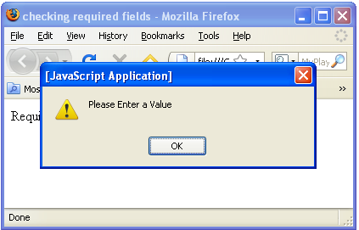
<script type='text/javascript'>
function notEmpty(elem, helperMsg)
{
if(elem.value.length == 0)
{
alert(helperMsg);
elem.focus();
return false;
}
return true;
}
</script>
<form> Required Field: <input type='text' id='req1'/>
<input type='button'
onclick="notEmpty(document.getElementById('req1'), 'Please Enter a Value')" value='Check Field' />
</form>

Slide 117
Form validation-checking for all numbers
If someone is entering a credit card, phone number, zip code, similar information you want to be able to ensure that the input is all numbers.
The quickest way to check if an input's string value is all numbers is to use a regular expression /^[0-9]+$/ that will only match if the string is all numbers and is at least one character long.
JavaScript Code:
// If the element's string matches the regular expression it is all numbers
function isNumeric(elem, helperMsg)
{
var numericExpression = /^[0-9]+$/;
if(elem.value.match(numericExpression))
{
return true;
}
else
{
alert(helperMsg);
elem.focus();
return false;
}
}

Slide 118
What we're doing here is using JavaScript existing framework to have it do all the hard work for us. Inside each string is a function called match that you can use to see if the string matches a certain regular expression. We accessed this function like so: elem.value.match(expressionhere).
We wanted to see if the input's string was all numbers so we made a regular expression to check for numbers [0-9] and stored it as numericExpression.
We then used the match function with our regular expression. If it is numeric then match will return true, making our if statement pass the test and our function isNumeric will also return true. However, if the expression fails because there is a letter or other character in our input's string then we'll display our helperMsg and return false.

Slide 119
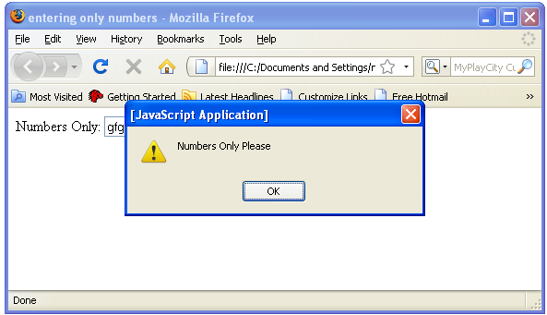
<script type='text/javascript'>
function isNumeric(elem, helperMsg)
{
var numericExpression = /^[0-9]+$/;
if(elem.value.match(numericExpression))
{
return true;
}
else
{
alert(helperMsg);
elem.focus();
return false;
}
}
</script>
<form>
Numbers Only: <input type='text' id='numbers'/>
<input type='button' onclick="isNumeric(document.getElementById('numbers'), 'Numbers Only Please')" value='Check Field' />
</form>

Slide 120
Form validation-checking for all letters
This function will be identical to isNumeric except for the change to the regular expression we use inside the match function. Instead of checking for numbers we will want to check for all letters.
If we wanted to see if a string contained only letters we need to specify an expression that allows for both lowercase and uppercase letters: /^[a-zA-Z]+$/
JavaScript Code:
// If the element's string matches the regular expression it is all letters function isAlphabet(elem, helperMsg)
{
var alphaExp = /^[a-zA-Z]+$/;
if(elem.value.match(alphaExp))
{
return true;
}
else
{
alert(helperMsg);
elem.focus();
return false;
}
}

Slide 121

<script type='text/javascript'>
function isAlphabet(elem, helperMsg)
{
var alphaExp = /^[a-zA-Z]+$/;
if(elem.value.match(alphaExp))
{
return true;
}
else
{
alert(helperMsg);
elem.focus();
return false;
}
}
</script>
<form>
Letters Only: <input type='text' id='letters'/>
<input type='button' onclick="isAlphabet(document.getElementById('letters'), 'Letters Only Please')" value='Check Field' />
</form>

Slide 122
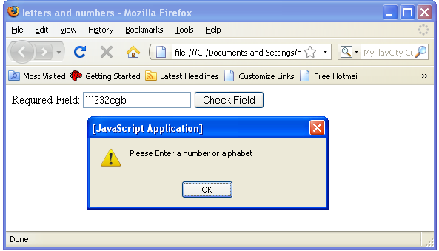
Form validation- for letters and numbers
By combining both the isAlphabet and isNumeric functions into one we can check to see if a text input contains only letters and numbers.
JavaScript Code:
// If the element's string matches the regular expression it is numbers and letters
function isAlphanumeric(elem, helperMsg)
{
var alphaExp = /^[0-9a-zA-Z]+$/;
if(elem.value.match(alphaExp))
{
return true;
}
else
{
alert(helperMsg);
elem.focus();
return false;
}
}

Slide 123
Form validation-restricting length
Being able to restrict the number of characters a user can enter into a field is one of the best ways to prevent bad data.
For example, if you know that the zip code field should only be 5 numbers you know that 2 numbers is not sufficient.
Below we have created a lengthRestriction function that takes a text field and two numbers.
The first number is the minimum number of characters and the second is the maximum number of a characters the input can be.
If you just want to specify an exact number then send the same number for both minimum and maximum.
JavaScript Code:
function lengthRestriction(elem, min, max)
{
var uInput = elem.value;
if(uInput.length >= min && uInput.length <= max)
{ return true; }
else
{
alert("Please enter between " +min+ " and " +max+ " characters");
elem.focus();
return false;
}
}

Slide 124
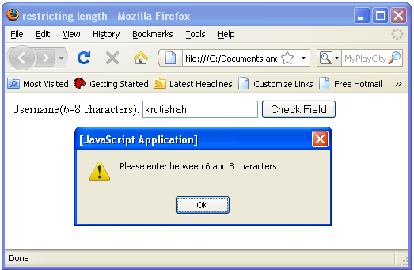
Here's an example of this function for a field that
requires 6 to 8 characters for a valid username.
<script type='text/javascript'>
function lengthRestriction(elem, min, max)
{
var uInput = elem.value;
if(uInput.length >= min && uInput.length <= max)
{
return true;
}
else
{
alert("Please enter between " +min+ " and " +max+ " characters");
elem.focus();
return false;
}
}
</script>
<form>
Username(6-8 characters): <input type='text' id='restrict'/>
<input type='button' onclick="lengthRestriction(document.getElementById('restrict'), 6, 8)" value='Check Field' />
</form>

Slide 125
Email Validation
The function below checks if the content has the general syntax of an email.
This means that the input data must contain at least an @ sign and a dot (.). Also, the @ must not be the first character of the email address, and the last dot must at least be one character after the @ sign:

Slide 126
Email Validations
<html> <head> <script type="text/javascript"> function validate_email(field,alerttxt) { with (field) { apos=value.indexOf("@"); dotpos=value.lastIndexOf("."); if (apos<1||dotpos-apos<2) {alert(alerttxt);return false;} else {return true;} } } function validate_form(thisform) { with (thisform) { if (validate_email(email,"Not a valid e-mail address!")==false) {email.focus();return false;} } } </script> </head> <body> <form action="submit.htm" onsubmit="return validate_form(this);" method="post"> Email: <input type="text" name="email" size="30"> <input type="submit" value="Submit"> </form> </body> </html>

Slide 127
Using regular expressions
var emailPattern = /^[a-zA-Z0-9._-]+@[a-zA-Z0-9.-]+\.[a-zA-Z]{2,4}$/; where,
\.: After the second group of characters there must be a period (‘.’). This is to separate domain and subdomain names.
{2,4} indicates the minimum and maximum number of characters. This will allow domain names with 2, 3 and 4 characters e.g.; us, tx, org, com, net, wxyz).

Slide 128
EXTRA……………

Slide 129
JavaScript Timing Events
With JavaScript, it is possible to execute some code after a specified time-interval. This is called timing events.
It's very easy to time events in JavaScript. The two key methods that are used are:
setTimeout() - executes a code some time in the future
clearTimeout() - cancels the setTimeout()

Slide 130
<html>
<head>
<script type="text/javascript">
function startTime()
{ var today=new Date();
var h=today.getHours();
var m=today.getMinutes();
var s=today.getSeconds();
// add a zero in front of numbers<10
m=checkTime(m);
s=checkTime(s);
document.getElementById('txt').innerHTML=h+":"+m+":"+s;
t=setTimeout('startTime()',500);
}
function checkTime(i)
{
if (i<10)
{
i="0" + i;
}
return i;
}
</script>
</head>
<body onload="startTime()">
<div id="txt"></div>
</body>
</html>

Slide 131
JavaScript frames
Using JavaScript we can change the contents of one frame from other frame.
parent.framename.attributes_to_change
Replacing framename with the name you gave the frame in your frameset, ie:
<FRAME src="jex2.htm" name="right_frame">
In this case, you would access something in that frame with:
parent.right_frame.attributes_to_change
Consider parent frame as follows:
<HTML>
<HEAD>
<TITLE>Frames Values</TITLE>
</HEAD>
<FRAMESET cols="20%,80%">
<FRAME SRC="jex1.htm" name="left_frame">
<FRAME SRC="jex2.htm" name="right_frame">
</FRAMESET>
</HTML>

Slide 132
Consider Left frame
<HTML>
<HEAD>
<TITLE>JavaScript Example 1</TITLE> </HEAD>
<BODY>
<FORM>
<INPUT type="button" value="Whats this?" onClick="parent.right_frame.document.form1.text1.value=‘a button!‘ ">
</FORM>
</BODY>
</HTML>
Consider right frame
<HTML>
<HEAD>
<TITLE>JavaScript Example2</TITLE> </HEAD>
<BODY>
<FORM name="form1">
<INPUT type="text" name="text1" size="25" value="">
</FORM>
</BODY>
</HTML>

Slide 133
JavaScript cookies
A cookie is often used to identify a user.
A cookie is a variable that is stored on the visitor's computer. Each time the same computer requests a page with a browser, it will send the cookie too. With JavaScript, you can both create and retrieve cookie values.
Examples of cookies:
Name cookie - The first time a visitor arrives to your web page, he or she must fill in her/his name. The name is then stored in a cookie. Next time the visitor arrives at your page, he or she could get a welcome message like "Welcome John Doe!" The name is retrieved from the stored cookie
Password cookie - The first time a visitor arrives to your web page, he or she must fill in a password. The password is then stored in a cookie. Next time the visitor arrives at your page, the password is retrieved from the cookie
Date cookie - The first time a visitor arrives to your web page, the current date is stored in a cookie. Next time the visitor arrives at your page, he or she could get a message like "Your last visit was on Tuesday August 11, 2005!" The date is retrieved from the stored cookie

Slide 134
Create a cookie
In this example we will create a cookie that stores the name of a visitor. The first time a visitor arrives to the web page, he or she will be asked to fill in her/his name. The name is then stored in a cookie. The next time the visitor arrives at the same page, he or she will get welcome message.
First, we create a function that stores the name of the visitor in a cookie variable:
function setCookie(c_name,value,expiredays) { var exdate=new Date(); exdate.setDate(exdate.getDate()+expiredays); document.cookie=c_name+ "=" +escape(value)+ ((expiredays==null) ? "" : ";expires="+exdate.toGMTString()); }
The parameters of the function above hold the name of the cookie, the value of the cookie, and the number of days until the cookie expires.
In the function above we first convert the number of days to a valid date, then we add the number of days until the cookie should expire.
After that we store the cookie name, cookie value and the expiration date in the document.cookie object.

Slide 135
Store a cookie
Then, we create another function that checks if the cookie has been set:
function getCookie(c_name) { if (document.cookie.length>0) { c_start=document.cookie.indexOf(c_name + "="); if (c_start!= -1) { c_start=c_start + c_name.length+1; c_end=document.cookie.indexOf(";",c_start); if (c_end==-1)
c_end=document.cookie.length; return unescape(document.cookie.substring(c_start,c_end)); } } return ""; }
The function above first checks if a cookie is stored at all in the document.cookie object.
If the document.cookie object holds some cookies, then check to see if our specific cookie is stored.
If our cookie is found, then return the value, if not - return an empty string.

Slide 136
Display a message if cookie is set
Last, we create the function that displays a welcome message if the cookie is set, and if the cookie is not set it will display a prompt box, asking for the name of the user:
function checkCookie() { username=getCookie('username'); if (username!=null && username!="") { alert('Welcome again '+username+'!'); } else { username=prompt('Please enter your name:',""); if (username!=null && username!="") { setCookie('username',username,365); } } }

Slide 137
JavaScript events
Events are actions that can be detected by JavaScript.
By using JavaScript, we have the ability to create dynamic web pages. Events are actions that can be detected by JavaScript.
Every element on a web page has certain events which can trigger a JavaScript. For example, we can use the onClick event of a button element to indicate that a function will run when a user clicks on the button. We define the events in the HTML tags.
Examples of events:
A mouse click
A web page or an image loading
Mousing over a hot spot on the web page
Selecting an input field in an HTML form
Submitting an HTML form
A keystroke
Note: Events are normally used in combination with functions, and the function will not be executed before the event occurs!

Slide 138
Some examples
onLoad and onUnload events: The onLoad and onUnload events are triggered when the user enters or leaves the page.
onFocus, onBlur and onChange: The onFocus, onBlur and onChange events are often used in combination with validation of form fields.
onSubmit: The onSubmit event is used to validate ALL form fields before submitting it.
onMouseOver and onMouseOut: onMouseOver and onMouseOut are often used to create "animated" buttons.

Slide 139
Some Events details…
onLoad and onUnload
The onLoad and onUnload events are triggered when the user enters or leaves the page.
The onLoad event is often used to check the visitor's browser type and browser version, and load the proper version of the web page based on the information.
Both the onLoad and onUnload events are also often used to deal with cookies that should be set when a user enters or leaves a page. For example, you could have a popup asking for the user's name upon his first arrival to your page. The name is then stored in a cookie. Next time the visitor arrives at your page, you could have another popup saying something like: "Welcome John Doe!".
onFocus, onBlur and onChange
The onFocus, onBlur and onChange events are often used in combination with validation of form fields.
Below is an example of how to use the onChange event. The checkEmail() function will be called whenever the user changes the content of the field:
<input type="text" size="30" id="email" onchange="checkEmail()">

Slide 140
Events (cont’d…)
onSubmit
The onSubmit event is used to validate ALL form fields before submitting it.
Below is an example of how to use the onSubmit event. The checkForm() function will be called when the user clicks the submit button in the form. If the field values are not accepted, the submit should be cancelled. The function checkForm() returns either true or false. If it returns true the form will be submitted, otherwise the submit will be cancelled:
<form method="post" action="xxx.htm" onsubmit="return checkForm()"> onMouseOver
The onmouseover event can be used to trigger a function when the user mouses over an HTML element:

